Slide 1
Audio Beat Detection with Application to Robot Drumming
~
Michael Engstrom

Slide 2
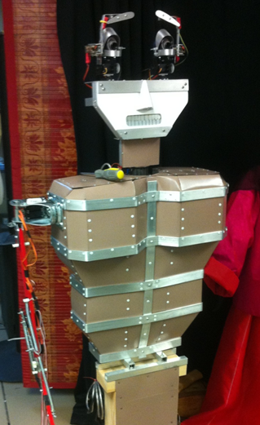
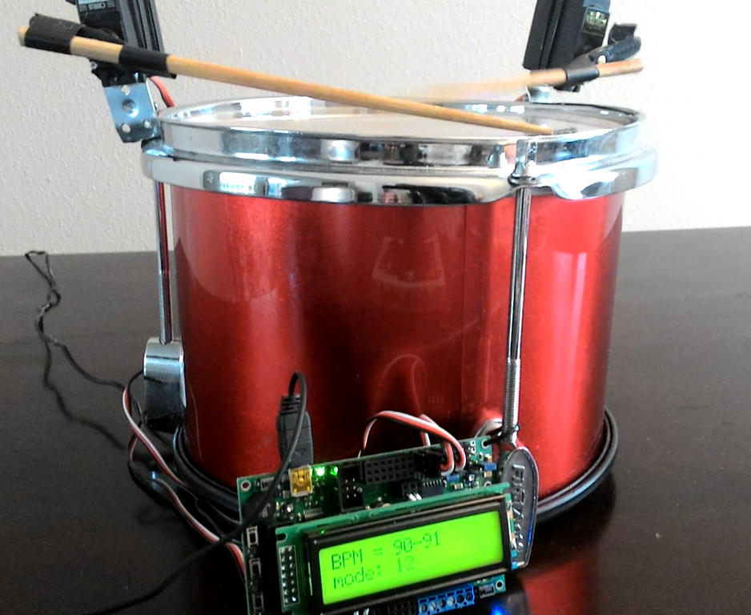
Drumming Robot & Robot Drum

Slide 3
Beat Detection Goals
Design a robot that will play drums in rhythm to an audio source which is detected in the environment
A robot control board will move servos to make arms and legs pound drums to a beat
An input device will detect the audio, extract the beat, and send the information to the robot controller

Slide 4
Beat Detection Phases
Software Design
Input of audio source
Beat detection
Output to robot controller
Mechanical Design
Arms and legs to beat drums
Interface to control software

Slide 5
Beat Detection
Tempo is complex
Counterpoint, grouping, hierarchy are subtly combined and interpreted by the human ear
Beat (or pulse) is simpler
The sense of equally spaced temporal units (Handel, 1989)
Detection using frequency decomposition
Fourier Transforms can detect frequency power trends to determine the beat of an audio sample
Notes:
Add video and pictures early to show what I am working with… Done!

Slide 6
Beat Detection
Audio input samples can be decomposed
Eric Scheirer developed a BPM Detection Algorithm in 1989
Algorithm steps:
Frequency Filterbank
Envelope Extraction (Fourier Transform)
Differentiation
Rectification
Comb Filter (to match sample to known bpm)
Notes:
Name algorithm author

Slide 7
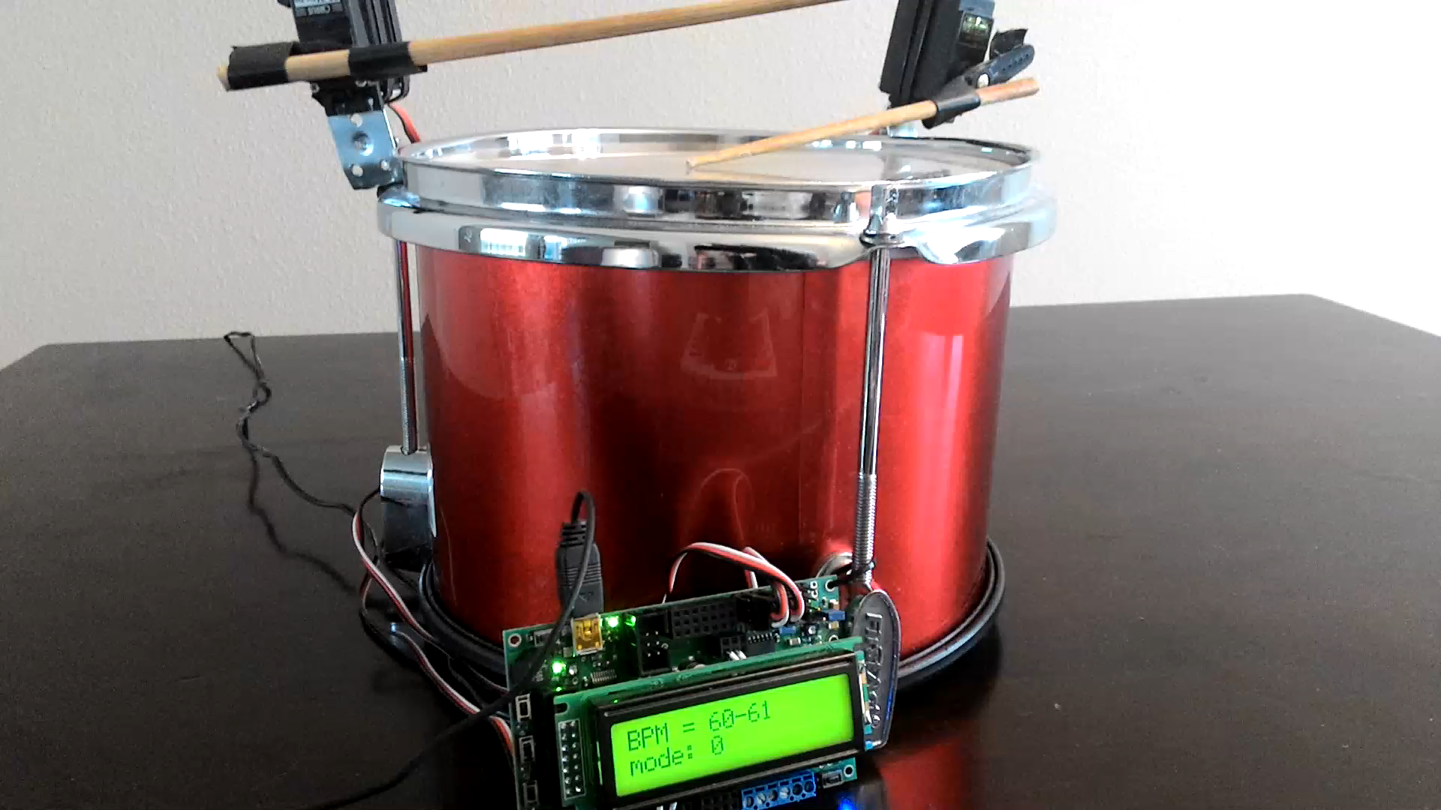
Drumming Robot in Action

Slide 8
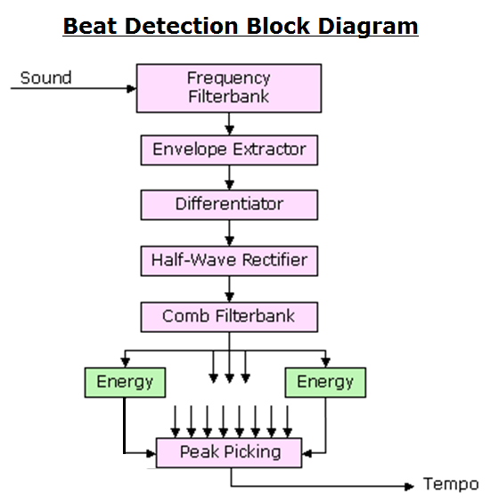

Slide 9
Beat Detection Algorithm
Step 1 – Frequency Filterbank
Split audio file into several frequency ranges
Similar instrument ranges can inhibit the detection of the beat
Allows for different instruments to be detected
0-200Hz, 200-400Hz, 400-800Hz, 800-1600Hz, 1600-3200Hz

Slide 10
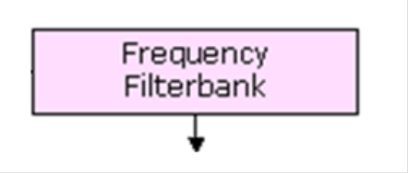
Beat Detection Algorithm
Step 1 – Frequency Filterbank
Each filter is implemented using a sixth-order elliptic filter
3 dB of ripple in the passband
40 dB of rejection in the stopband.

Slide 11
Beat Detection Algorithm
A Butterworth lowpass filter command in MATLAB
[n, Wn] = buttord(Wp,Ws,Rp,Rs)
Wp: Passband corner (cutoff) frequency
Ws: Stopband corner frequency
Rp: Passband ripple
Rs: Stopband attenuation
Returns
n: Lowest filter order (as integer scalar)
Wn: Cutoff frequencies (as scalar or vector)

Slide 12
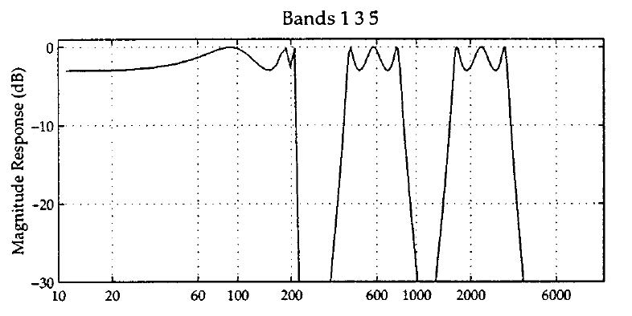
Beat Detection Algorithm
Step 1 – Frequency Filterbank

Slide 13
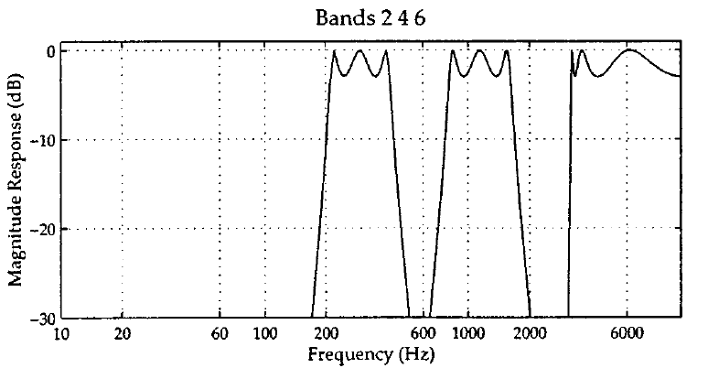
Beat Detection Algorithm
Step 1 – Frequency Filterbank

Slide 14
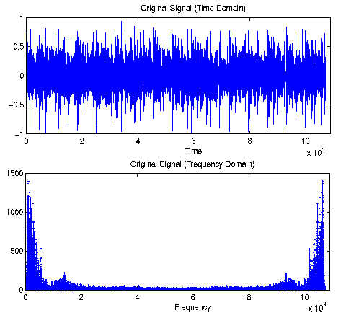
Fourier Transforms
Convert a signal from Time to Frequency Domain
Separates frequency and magnitude components

Slide 15
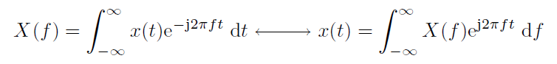
Fourier Transforms
Convert a signal from Time to Frequency Domain
Separates frequency and magnitude components
Fourier Transform Pair:
Note that the algorithm completes after multiplying the Frequency Domain signal and does not need to convert the signal to the Time Domain after this operation.

Slide 16
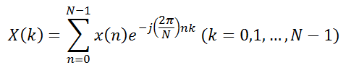
Fourier Transforms
Convert a signal from Time to Frequency Domain
Separates frequency and magnitude components
The Discrete Fourier Transform for digital signals:
The number of samples N affects calculation speed
Larger number of samples increases accuracy but also increases calculation time
Parameterization of values helped determine the best tradeoff of speed and accuracy

Slide 17
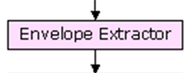
Beat Detection Algorithm
Step 2 – Envelope Extractor
Filter each of the signal segments
Convert to Frequency Domain using FFT or DFT
Convolve and transform signal
Multiplication in Frequency Domain is the same as Convolution in the Time Domain

Slide 18
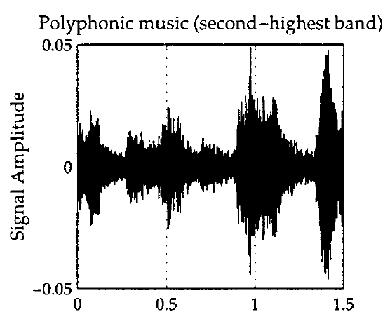
Beat Detection Algorithm
Step 2 – Envelope Extractor: 1.5s sample
Input signal is noisy and duplicates information

Slide 19
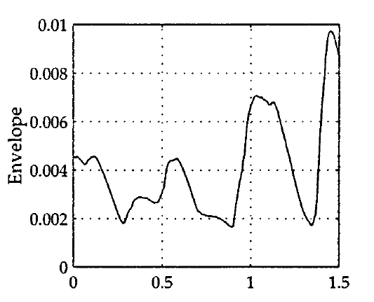
Beat Detection Algorithm
Step 2 – Envelope Extractor: 1.5s sample
Signal shape is retained and noise is removed

Slide 20
Beat Detection Algorithm
Step 2 – Windowing with Hanning Window
Signals which have components outside the sampling range of Fourier Transform operations can cause ‘leakage’
Leakage affects the accuracy of the signal representation in the Frequency Domain
Applying a bandpass filter to the signal before performing the transform improves the result of the operation

Slide 21
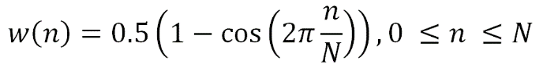
Beat Detection Algorithm
Step 2 – Windowing with Hanning Window as shown in the equation by
where n = bin number (for Spectrum analyzer equipment the number of bins is the granularity of frequency representation) and N = number of bins (number of slices displayed on a screen). (Source: Witte)

Slide 22
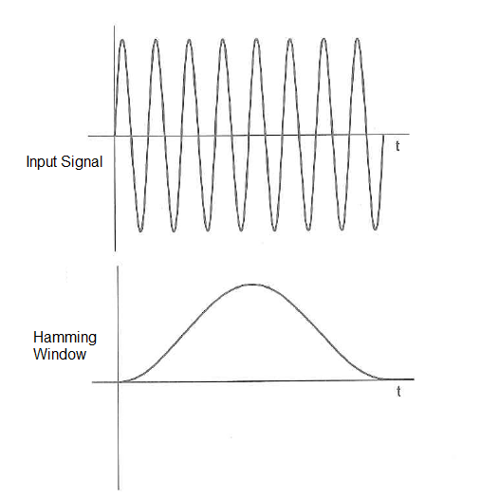
An input signal is multiplied with a Hamming Window
(Source: Witte)
Notes:
Add slides for input signal with leakage and how windowing improves. Done

Slide 23
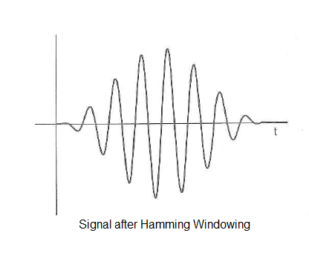
The signal is tapered to zero as each end is approached.
Transients will not be introduced with the windowed signal during the FFT algorithm
(Source: Witte)
Notes:
Add slides for input signal with leakage and how windowing improves

Slide 24
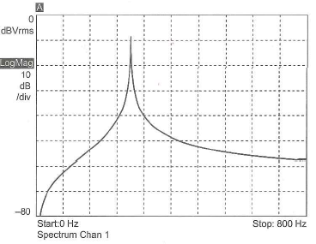
Beat Detection Algorithm
Below is an FFT of a signal with spectral leakage present. The detected frequency magnitude is reduced and spread out.
(Source: Witte)
Notes:
Add slides for input signal with leakage and how windowing improves

Slide 25
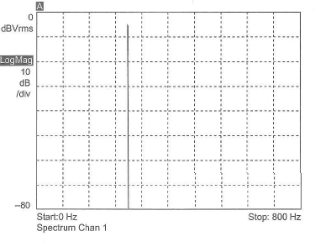
Beat Detection Algorithm
Below is an FFT of a windowed signal. The detected frequency magnitude is higher and there are no diffused frequency elements.
(Source: Witte)

Slide 26
Beat Detection Algorithm
Steps 3 & 4 combined in one MATLAB module
Step 3 – Differentiate signal
Accentuate when the sound changes
Corresponds to beats
Step 4 – Rectify signal
Only see changes in sound
Signals ready to be analyze
Example on next slide from MATLAB

Slide 27
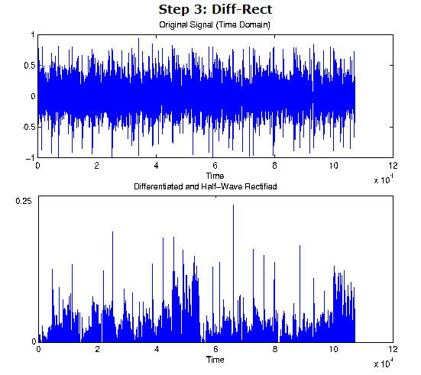
Half-wave rectified signal retains positive values
Notes:
Add original signal to compare what this effect is

Slide 28
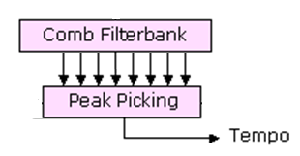
Beat Detection Algorithm
Step 5 – Comb Filter
Use various filters
Determine which has highest energy
Maximum value is the fundamental tempo

Slide 29
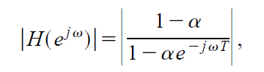
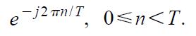
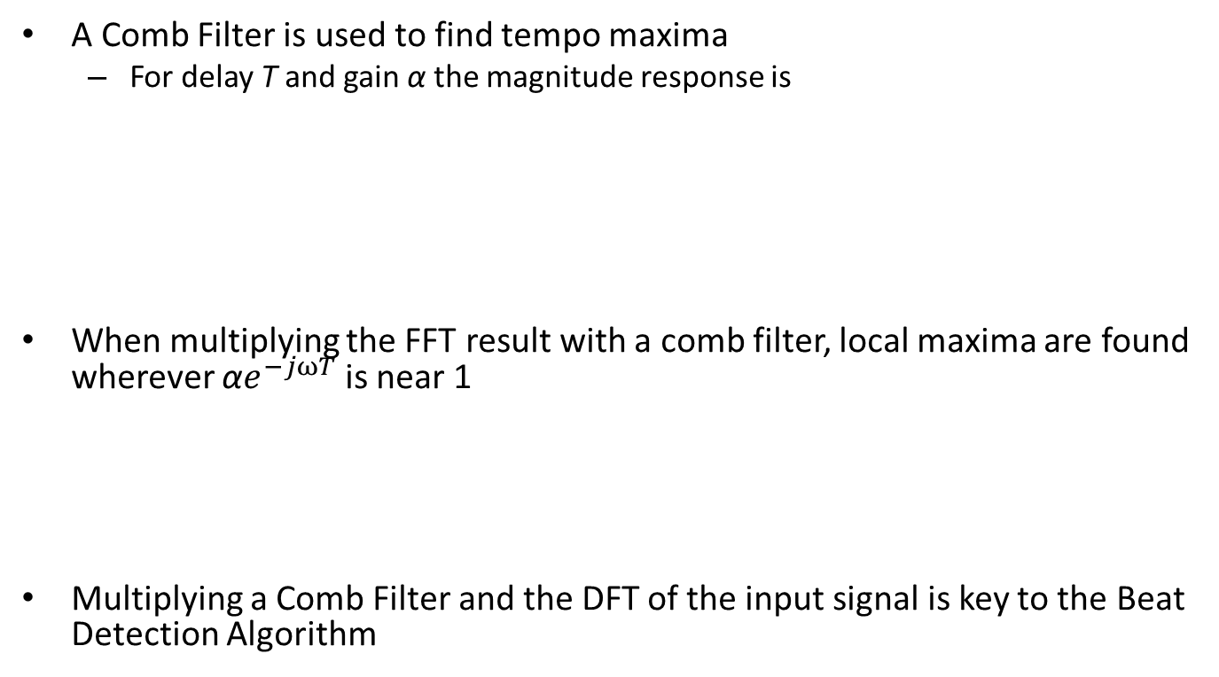
Beat Detection Algorithm
A Comb Filter is used to find tempo maxima
For delay T and gain α the magnitude response is
When multiplying the FFT result with a comb filter, local maxima are found wherever ${\text{α}e}^{−jωT}$ is near 1
Multiplying a Comb Filter and the DFT of the input signal is key to the Beat Detection Algorithm

Slide 30
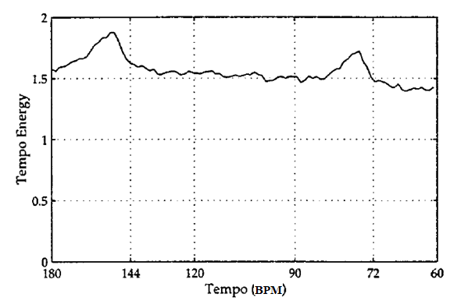
Beat Detection Algorithm
A signal at 150BPM below shows energy also at the 75BPM octave

Slide 31
Software Design – Host Side
MATLAB Software Functionality:
Input audio from file or microphone
.wav file or 10 seconds of microphone sample
Follow Scheirer Algorithm in Matlab
Find FFT of input signal and multiply with Comb Filters of known BPM
Keep highest multiplied output value, discard others
Result is BPM value
Send BPM control value using Serial connection to Robot Controller
Notes:
Clarify algorithm name and author. Maybe have a version of this slide near the beginning of presentation.

Slide 32
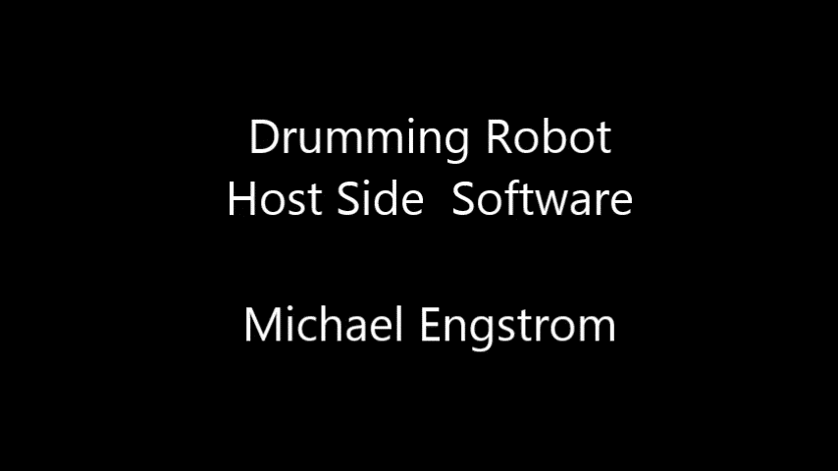
Host Side BPM Detection

Slide 33
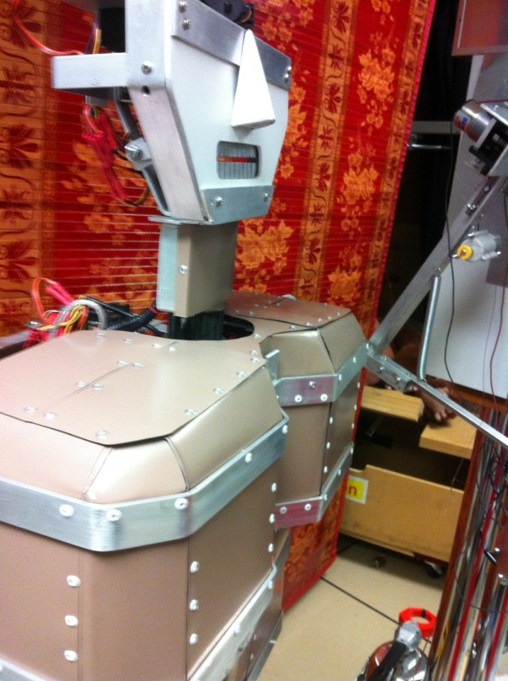
Robot Design
The serial control signal is sent to robot controller for the ‘DIM’ robot arm movement

Slide 34
Robot - Mechanical Design
Added limbs to the DIM robot (as seen in the Robot Theater window)
Servo motors utilized for motion of arms and shoulders
Implemented Pololu ‘Orangutan SVP’ robot controller for servo movement

Slide 35
Robot - Mechanical Design
Arms and legs to beat drums
Constructed of lamps, casters and servos
Allowed for 3 degrees of freedom per arm
Drumming arms attached to ‘DIM’ robot torso
Shoulder and elbow movement simulates humanoid range and motion while drumming

Slide 36
Robot - Mechanical Design

Slide 37
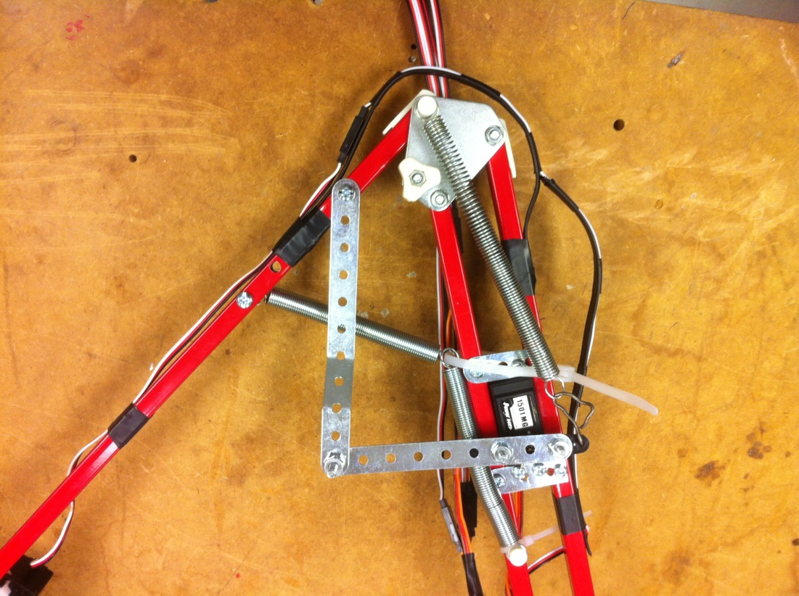
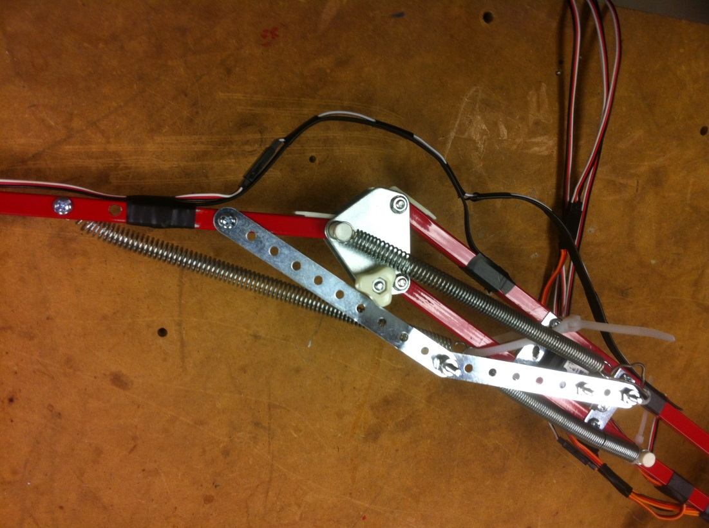
Robot - Mechanical Design
Arms
Lamp arms purchased from thrift store
Offset servo moves arm indirectly (not at joint)

Slide 38
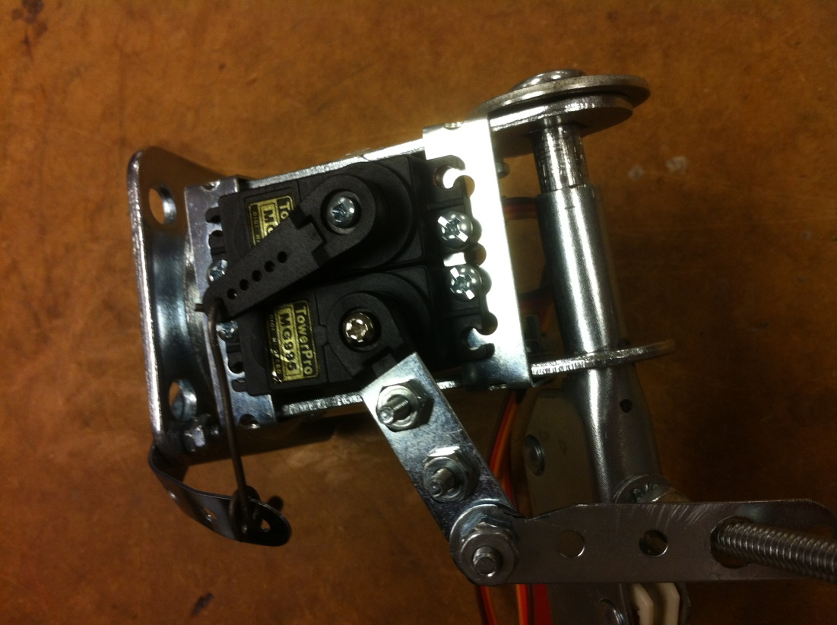
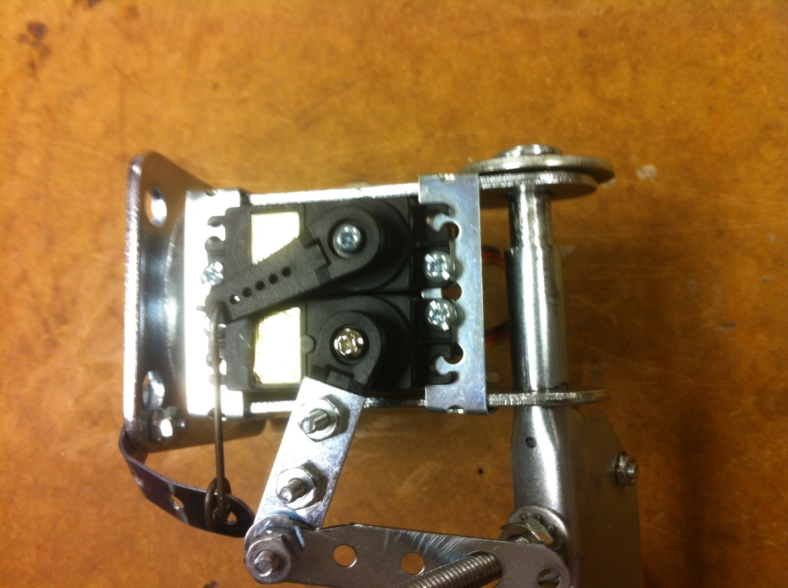
Robot - Mechanical Design
Arms
Shoulder made from caster with wheel removed and servos mounted (side to side motion shown).

Slide 39
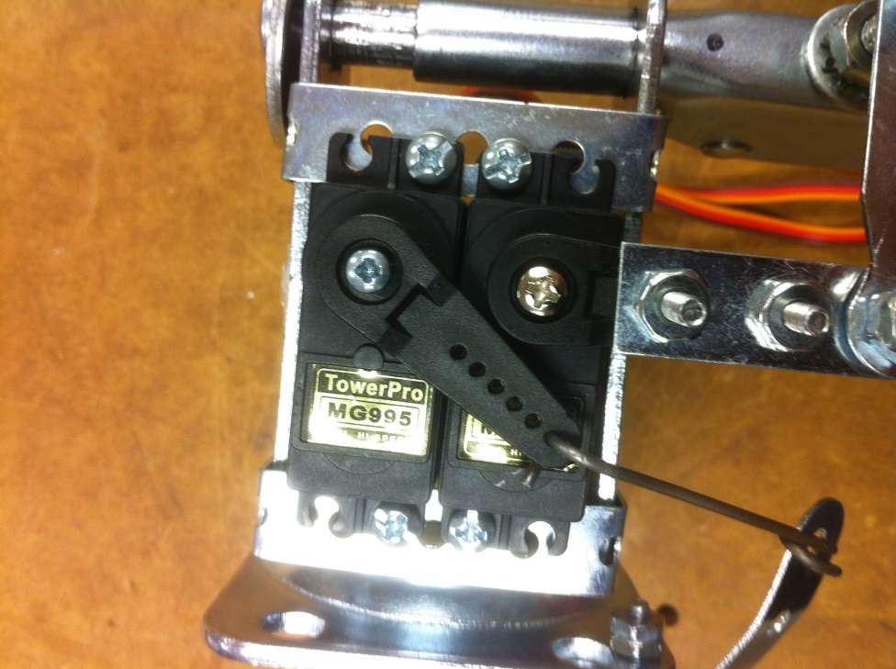
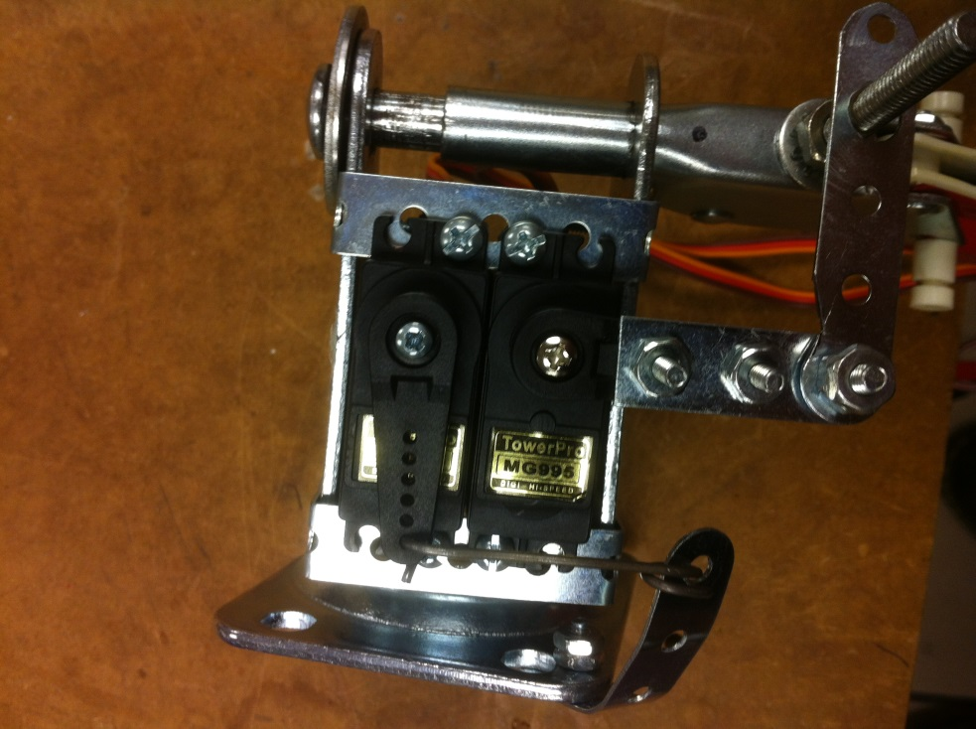
Robot - Mechanical Design
Arms
Close-up of shoulder up and down motion

Slide 40
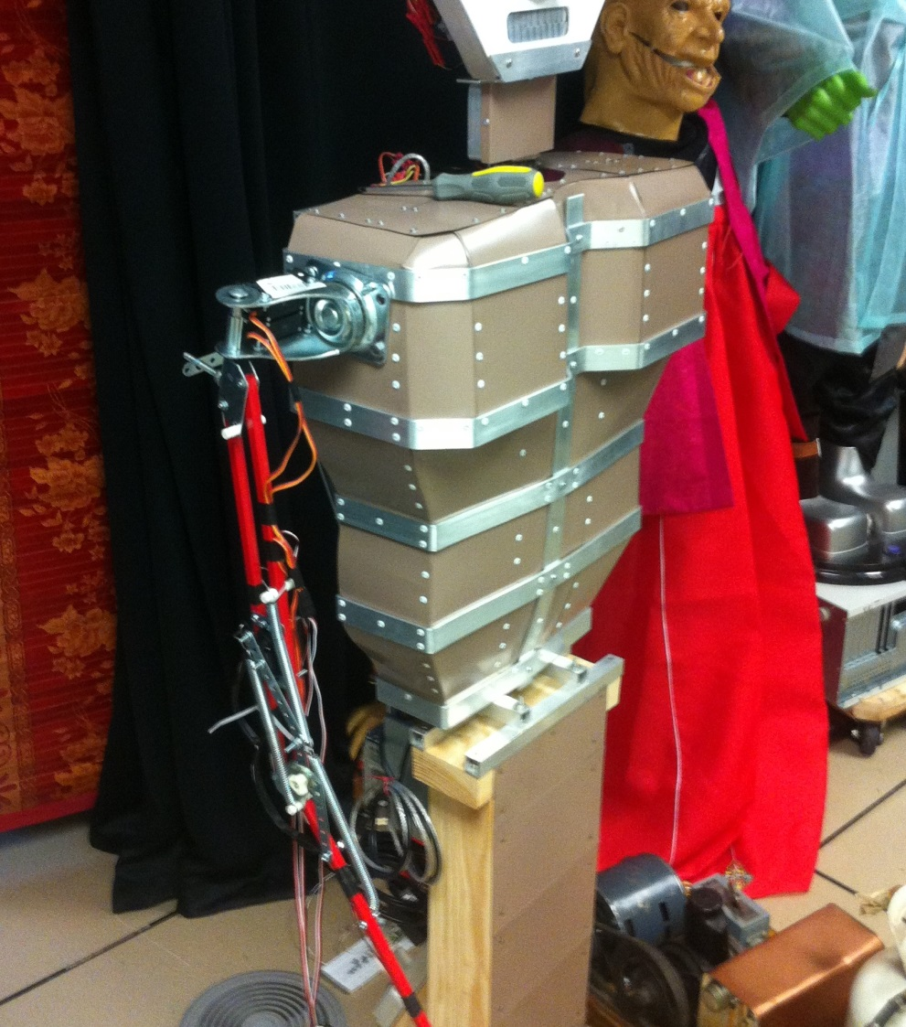
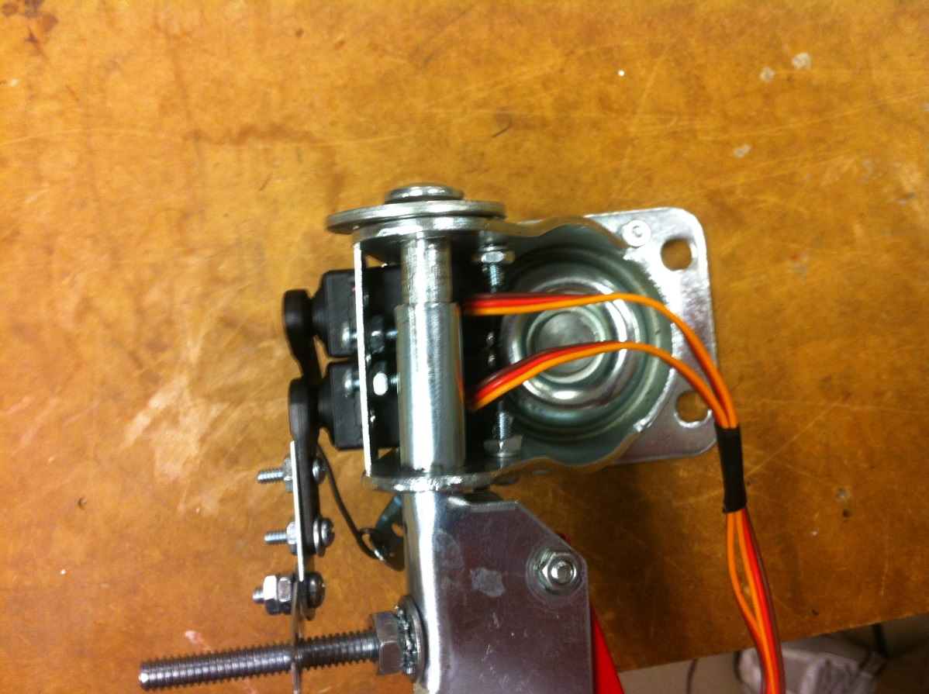
Robot - Mechanical Design
Completed Arms
Mounted on Robot torso

Slide 41
Robot – Hardware Controller Design
Serial interface to Orangutan board
Pololu robot controller
Receives BPM and control information from Host
Can also be controlled by on board buttons
Output is drumming movement in time with BPM using servos to move robot arms
Robot Controller changes BPM of drumming every time new serial BPM data is received from host

Slide 42
Robot – Hardware Controller Design
Software
Pololu Robot Controller
Interface to control software
Input Serial BPM data
Move robot limbs to drum at BPM
Next are some details regarding servos and the Orangutan Robot Controller

Slide 43
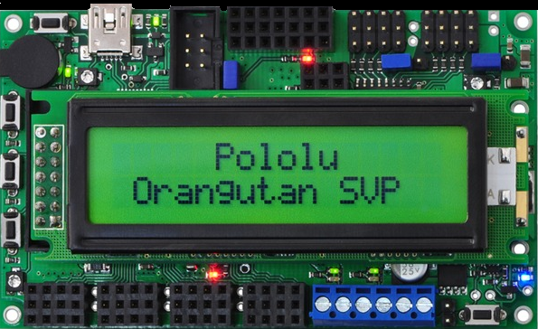
A closeup view of the Orangutan SVP and the onboard components

Slide 44
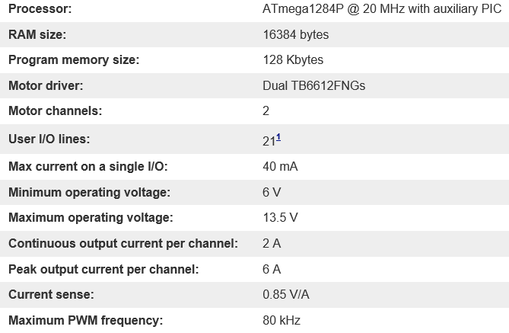
Orangutan Controller Specifications

Slide 45
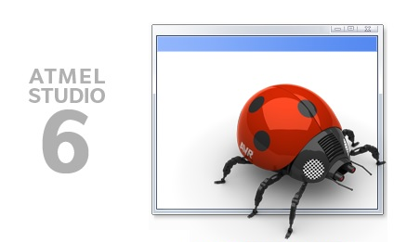
Atmel Orangutan Programming
Atmel Studio Development Software
Benefits of programming the Orangutan in C code
APIs available for servos, LEDs, serial data, etc.

Slide 46
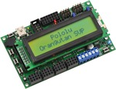
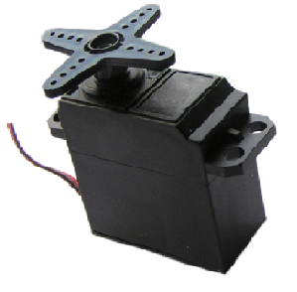
Atmel Orangutan Programming
The Orangutan Robot Controller can control 8 servos using dedicated servo connections and programming APIs.

Slide 47
Atmel Orangutan Programming
The Orangutan Robot Controller can control 8 more servos by allocating GPIO pins. This requires manual programming of the control signal, however.
Notes:
Combine with previous slide

Slide 48
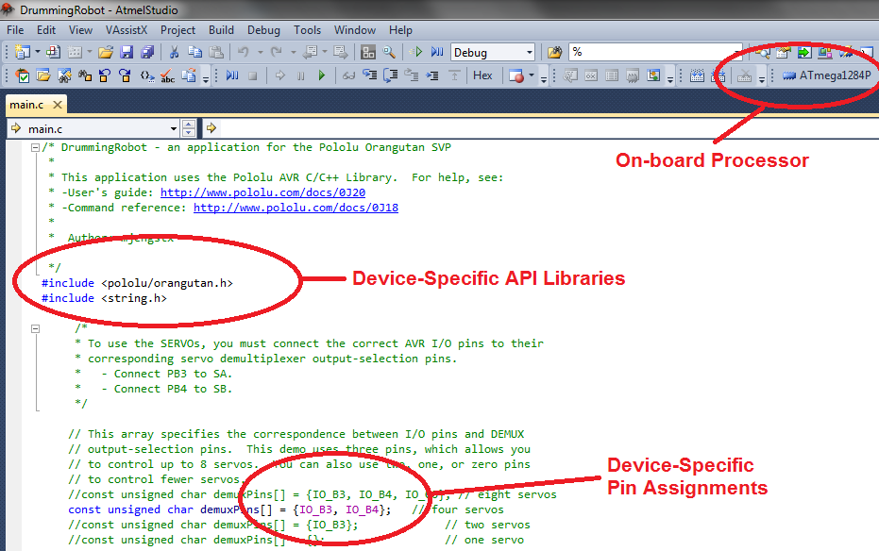
Atmel Orangutan Programming

Slide 49
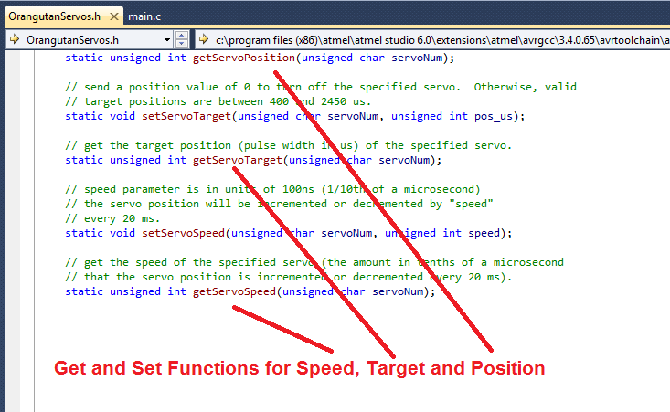
Atmel Orangutan Programming

Slide 50
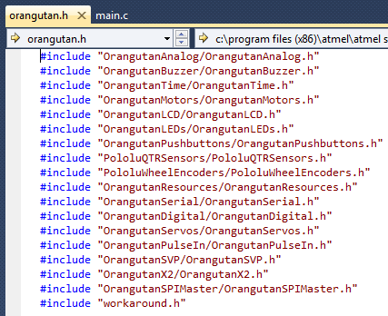
Atmel Orangutan Programming

Slide 51
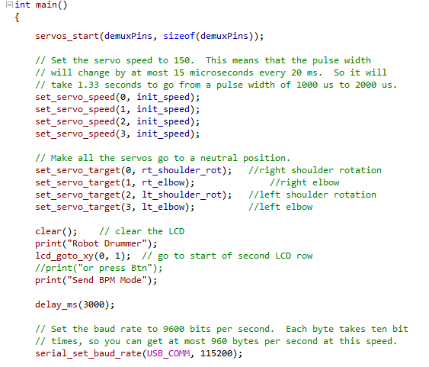
Orangutan Implemented Functions

Slide 52
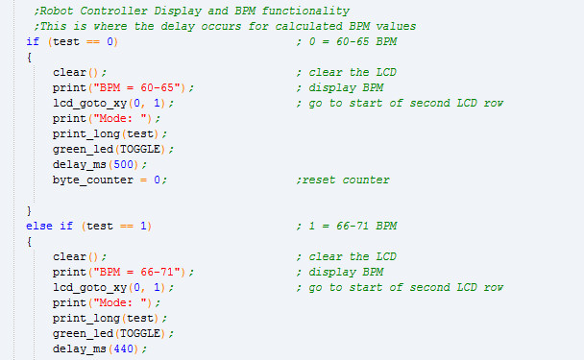
Drumming State Machine Code Initial [0,9] byte Implemenation

Slide 53
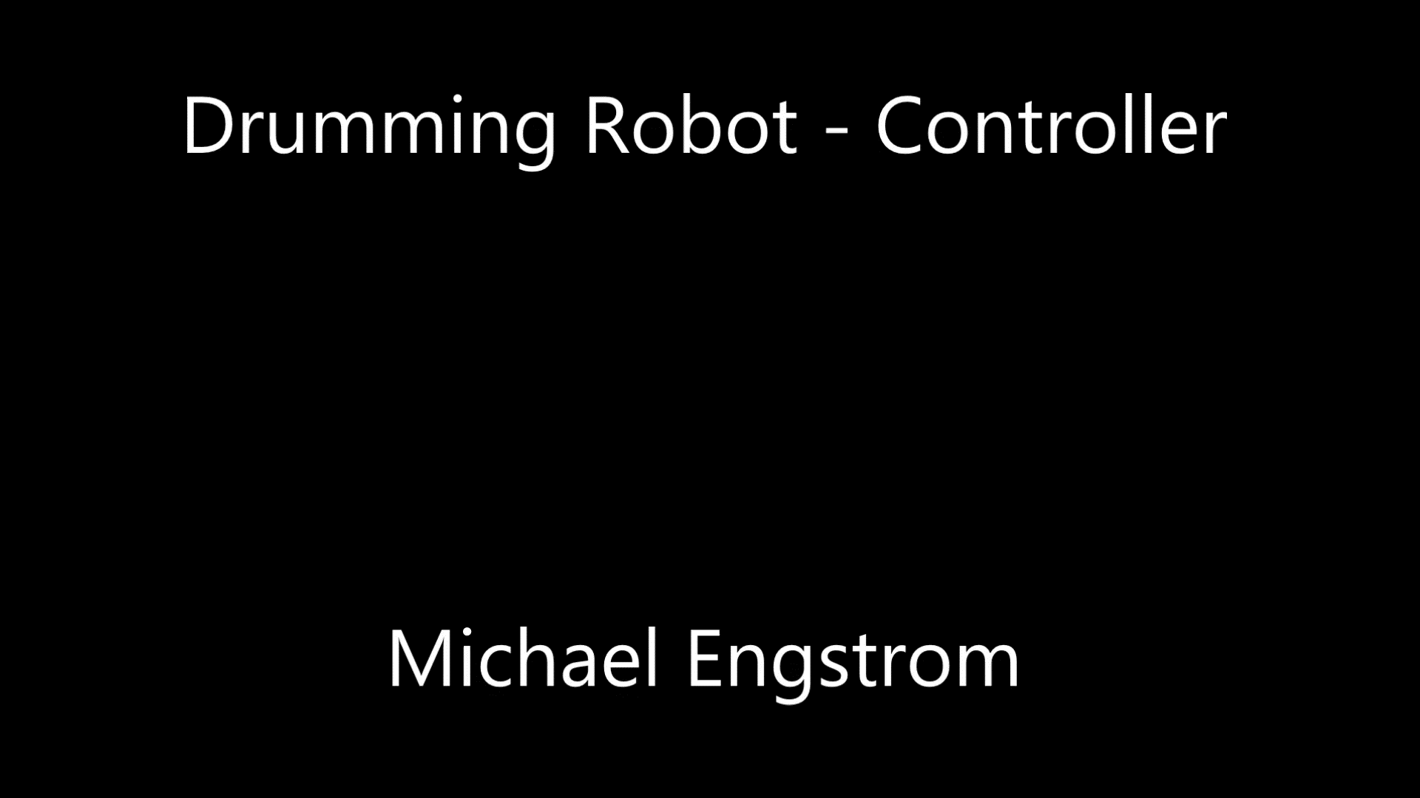
Robot Controller in Action

Slide 54
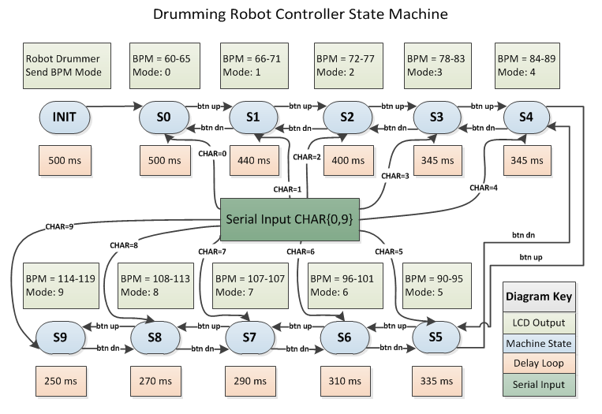
Drumming State Machine Code Initial [0,9] byte Implementation

Slide 55
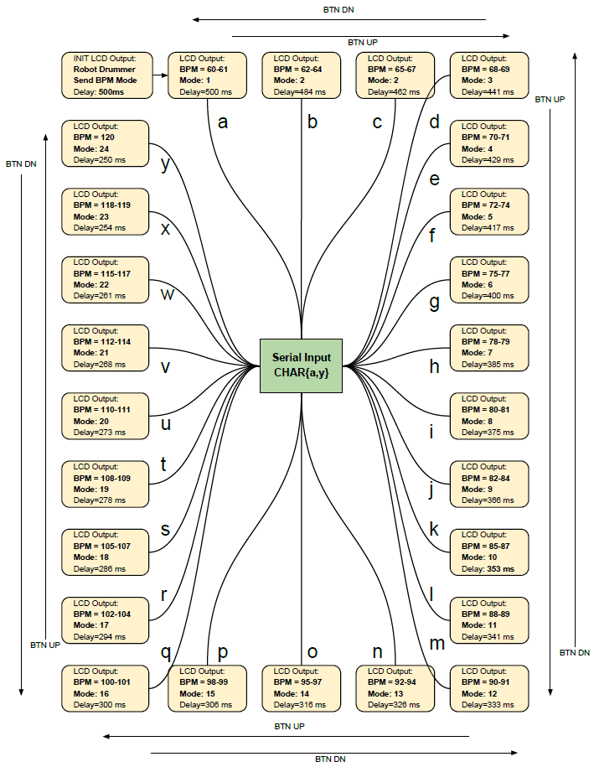
Improved [a,z] byte Implementation

Slide 56
Robot Controller States
The next slide shows the Byte Input from the host processor along with the outputs generated by the Robot Controller code:
S.M. (State Machine) Mode
Effective BPM
Delay Loop(ms) used to generate the desired BPM by the ration of [1/Delay(ms)]

Slide 57
Byte Input | S.M. Mode | Effective BPM | Loop Delay(ms)
a | 1 | 60 | 500
b | 2 | 62 | 484
c | 3 | 65 | 462
d | 4 | 68 | 441
e | 5 | 70 | 429
f | 6 | 72 | 417
g | 7 | 75 | 400
h | 8 | 78 | 385
i | 9 | 80 | 375
j | 10 | 82 | 366
k | 11 | 85 | 353
l | 12 | 88 | 341
m | 13 | 90 | 333
n | 14 | 92 | 326
o | 15 | 95 | 316
p | 16 | 98 | 306
q | 17 | 100 | 300
r | 18 | 102 | 294
s | 19 | 105 | 286
t | 20 | 108 | 278
u | 21 | 110 | 273
v | 22 | 112 | 268
w | 23 | 115 | 261
x | 24 | 118 | 254
y | 25 | 120 | 250

Slide 58
Robot Controller States
The next slide shows the Serial Module input from the host over the serial connection and button press
The Robot Controller uses a State Machine to determine the outputs at each BPM state:
Delay(ms)
Servo position
LED on/off
LCD screen text

Slide 59
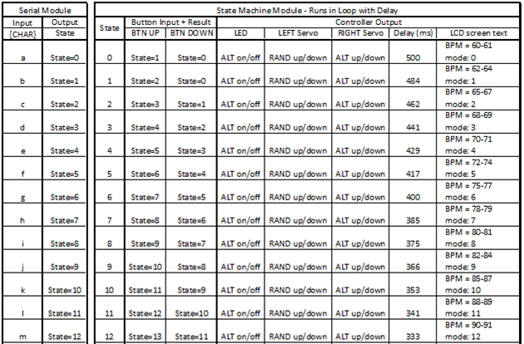
Partial sample of Robot Controller outputs

Slide 60
Robot Controller States
As can be observed in the Left Servo column, the arm movement of up/down is randomly determined
During testing the monotonous sound of the drum beats was tiresome
Adding a random element to the one arm introduced a pleasing random pattern of drumbeats
Right arm is always in time with the calculated BPM and the left arm lends some character to the drumming pattern
Notes:
Change back to bullet points DoNE

Slide 61
Testing
Next we will look at the testing that was performed to assess the operation of the algorithm and improve the speed & accuracy of the results.

Slide 62
Algorithm Testing
A series of ‘click tracks’ consisting of rhythmic pulses was created using Audacity
These files were used to test the accuracy of the host-side BPM Detection algorithm
Beat: | 35 BPM | 55 BPM | 60 BPM | 65 BPM | 70 BPM | 75 BPM | 80 BPM | 85 BPM
90 BPM | 95 BPM | 100 BPM | 105 BPM | 110 BPM | 115 BPM | 120 BPM | 125 BPM | 145 BPM
Notes:
Insert example audio of click track DONE

Slide 63

Algorithm Testing
The range of BPM Detection was set at 60-120 BPM. The click tracks included several files outside the range.
Beat: | 35 BPM | 55 BPM | 60 BPM | 65 BPM | 70 BPM | 75 BPM | 80 BPM | 85 BPM
90 BPM | 95 BPM | 100 BPM | 105 BPM | 110 BPM | 115 BPM | 120 BPM | 125 BPM | 145 BPM

Slide 64
Algorithm Testing - Parameterization
A parameter set was used in 20 combinations to vary the values given to the algorithm. The results were calculated and graphed to determine calculation time and accuracy.
 | Range
Band Limits | None to [0 200 400 800 1600 3200]
Sample Rate | [2048, 4096, 8192, 16384]
Scaling | [0.75, 1.0, 1.25, 1.5]

Slide 65
Algorithm Testing - Parameterization
Parameter values varied Band Limits, 4 different sample rates, and scaling factors added to the calculated results. Higher sample rates were more accurate but took longer to finish calculating.
 | Range
Band Limits | None to [0 200 400 800 1600 3200]
Sample Rate | [2048, 4096, 8192, 16384]
Scaling | [0.75, 1.0, 1.25, 1.5]

Slide 66

Algorithm Testing – Time vs. Error
The input files for testing were of known BPM values. By varying the combinations of input parameters a range of results was obtained.
The goal was Time < 10s and Error < 10%
Error was calculated with this formula:

Slide 67
Algorithm Testing – Time vs. Error
The results were graphed and examined

Slide 68
Algorithm Testing – Time vs. Error
Multiple results were within the goal

Slide 69
Algorithm Testing – Time vs. Error
One parameter set was within 5s and 5% error

Slide 70
Algorithm Testing – Time vs. Error
This result highlights 4.5 seconds calculation time and 4.51% average error for the BPM. This was well within our error and time goals.
(4.5s, 4.51%) | Values with best result of (Time, Error)
Band Limits | None to [0 200 400 800 1600 3200]
Sample Rate | [2048, 4096, 8192, 16384]
Scaling | [0.75, 1.0, 1.25, 1.5]

Slide 71
Comparison with Rice team results (Error calculations added on right)
Song | Human-Detected Tempo (BPM) | Machine-Detected Tempo (BPM) | Error (%) 100*abs(expected -measured)/measured
Beverly Hills Cop Theme | 119 | 80.06 | 48.64
Lil Jon - Bia Bia | 78 | 59.51 | 31.07
Venga Boys - Boom | 139 | 140.16 | 0.83
Corelli | 91 | 185.98 | 2.14
Copland - Fanfare for the Common Man | 118 | 118.13 | 0.11
Green Acres Theme | 119 | 62.68 | 5.07
Stan Getz - Girl from Ipanema | 137 | 136.73 | 0.20
Will Smith - Getting Jiggy With It | 110 | 109.5 | 0.46
Jurassic Park Theme | 110 | 109.89 | 0.10
Green Day - Longview | 152 | 77.67 | 2.15
Limp Bizkit - Rollin' | 185 | 186.19 | 0.64

Slide 72
Comparison with Rice team results (Error calculations added on right)
Song | Human-Detected Tempo (BPM) | Machine-Detected Tempo (BPM) | Error (%) 100*abs(expected -measured)/measured
Beverly Hills Cop Theme | 119 | 80.06 | 48.64
Lil Jon - Bia Bia | 78 | 59.51 | 31.07
Some of Rice’s calculations had an extremely high Error (%) while others were extremely low. Their implementation did not include parameterization of variables.

Slide 73
Comparison with Rice team results
I was satisfied with the results by using the method of parameterization of results to find the best combination of Time and Error
Rice was not using the algorithm in a Real Time implementation as with the Drumming Robot
Rice project goals were therefore not likely to include optimizing for calculation time.
Next is a recap of media of the Drumming Robot in action.
Notes:
More bullets

Slide 74
Videos
Drumming Robot Media Recap
Drumming Robot Host Side
Drumming Robot Controller
Drumming Robot Full System
Heartbeat click track at 95BPM
Notes:
Embed more drum videos

Slide 75
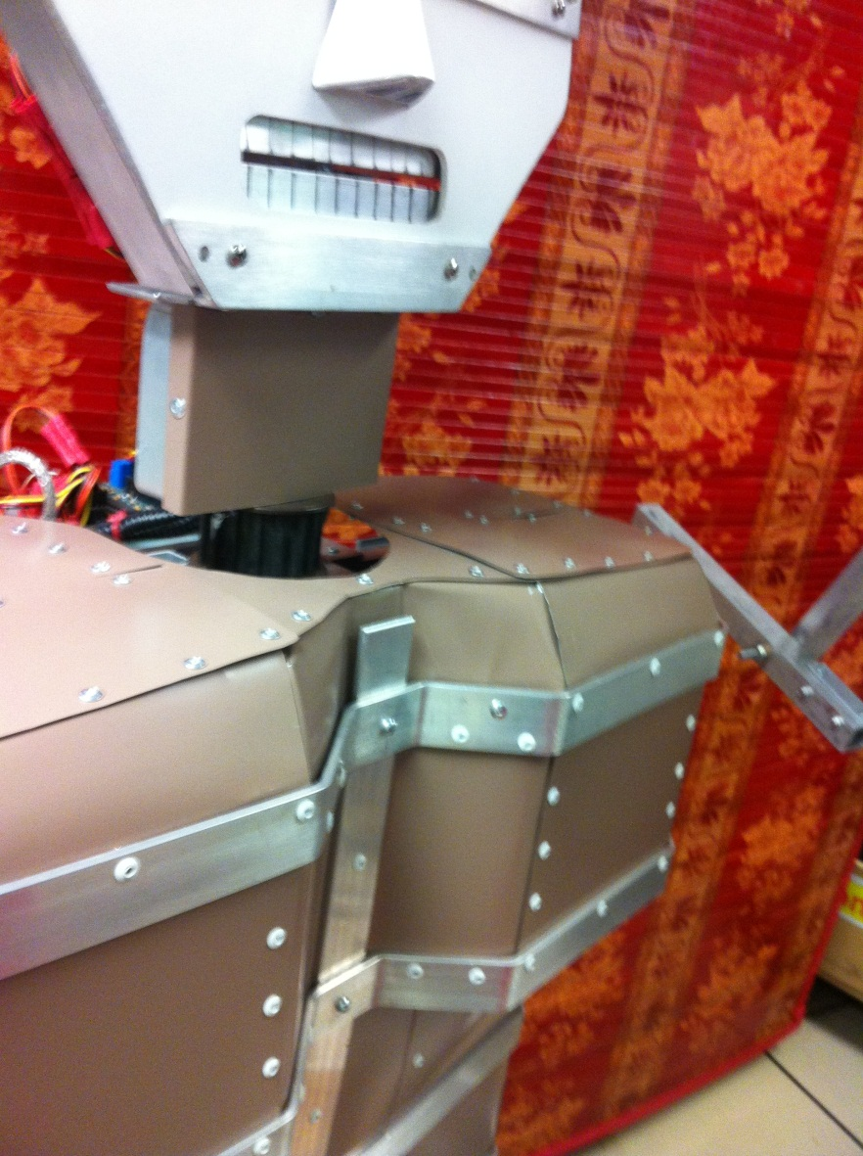
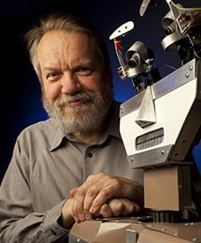
Questions?

Slide 76
References
Scheirer, Eric D. (1997). Tempo and beat analysis of acoustic musical signals. MIT Media Laboratory.
Cheng, Kileen; Nazer, Bobak; Uppuluri, Jyoti; Verret, Ryan (2001). Beat This – A Beat Synchronization Project. Rice University.
Handel, Stephen (1989). Listening. MIT Press.
Large, Edward W. and Kolen, John F. (1994). Resonance and the Perception of Musical Meter. Connection Science, Vol. 6, Nos. 2 & 3, p. 177.
Afonso, Valtino X.; Thompkins, Willis J.; Nguyen, Truong Q.; Luo, Shen (1999). ECG Beat Detection Using Filter Banks. IEEE Transactions on Biomedical Engineering, Vol. 46, No. 2.
Povel, Dirk-Jan and Essens, Peter (1985). Perception of Temporal Patterns. Music Perception: An Interdisciplinary Journal, Vol. 2, No. 4.
Jackson, Preston A.; Chan, Cy P.; Scalera, Jonathan E.; Rader, Charles M.; Vai, Michael (2004). A Systolic FFT Architecture for Real Time FPGA Systems. MIT Lincoln Laboratory.
Buso, Vincent (2012). VLSI Report. Illinois Institute of Technology.
Gerez, Sabih H. (2013). Hardware Implementations of the Fast Fourier Transform (FFT). University of Twente, The Netherlands.
Meyer-Baese, U. (2007). Digital Signal Processing with Field Programmable Gate Arrays. Springer.
Witte, Robert A. (2014). Spectrum and Network Measurements. SciTech.
Smith, Steven W. (2011). The Scientist and Engineer’s Guide to Digital Signal Processing. California Technical Publishing.
McKinney, Martin F. and Breebaart, Jeroen (2003). Features for Audio and Music Classification. Johns Hopkins University.
Lu, Li; Jiang, Hao; Zhang, HongJiang (2001). A Robust Audio Classification and Segmentation Method. ACM Multimedia.
O’Haver, Tom (2016). A Pragmatic Introduction to Signal Processing. University of Maryland at College Park.
Davies, Matthew E. P. and Plumbley, Mark D. (2006). A Spectral Difference Approach to Downbeat Extraction in Musical Audio. University of London Center for Digital Music.
Farid, Hany and Simoncelli, Eero P. (2004). Differentiation of Discrete Multi-Dimensional Signals. IEEE Transactions on Image Processing, Vol. 20, No. 20.

